Slide 1
INSIGHT
On favorable used browsers, devices, OS and platform
Dataset: Sample 1%

Slide 2
FAVORABLE BROWSERS 1ST = CHROME MOBILE (20.3%) 2ND = FACEBOOK (9.3%) 3RD = CHROME (7.4%)
Value | Count | Frequency (%)
chrome mobile;88.0.4324 | 79941 | 20.3%
facebook;304.0.0 | 36718 | 9.3%
chrome;88.0.4324 | 29106 | 7.4%
chrome mobile;87.0.4280 | 20405 | 5.2%
facebook;305.1.0 | 11707 | 3.0%
chrome mobile;86.0.4240 | 10337 | 2.6%
chrome mobile;80.0.3987 | 8882 | 2.3%
chrome mobile;83.0.4103 | 7655 | 1.9%
chrome mobile;81.0.4044 | 6556 | 1.7%
chrome mobile;85.0.4183 | 6259 | 1.6%
Other values (1374) | 176183 | 44.7%

Slide 3
FAVORABLE DEVICES 1ST = SMARTPHONE (23.9%) 2ND = OTHER (12.1%) 3RD = ANDROID (4.3%)
Value | Count | Frequency (%)
generic;generic smartphone | 94170 | 23.9%
;other | 47531 | 12.1%
generic_android;wv | 17007 | 4.3%
apple;iphone | 16574 | 4.2%
generic_android;cph1803 | 5076 | 1.3%
generic_android;cph1909 | 5075 | 1.3%
xiaomi;xiaomi redmi 6a | 4809 | 1.2%
xiaomi;xiaomi redmi note 8 | 4349 | 1.1%
xiaomi;xiaomi redmi 5a | 4300 | 1.1%
samsung;samsung sm-g610f | 3777 | 1.0%
Other values (2438) | 191081 | 48.5%

Slide 4
FAVORABLE OS 1ST = Android 10 2ND = Android 9 3RD = Android 8.1.0
Value | Count | Frequency (%)
android;10 | 106787 | 27.1%
android;9 | 73418 | 18.6%
android;8.1.0 | 57611 | 14.6%
windows;10 | 29694 | 7.5%
android;6.0.1 | 13229 | 3.4%
android;7.1.2 | 11757 | 3.0%
windows;7 | 11485 | 2.9%
android;7.1.1 | 11359 | 2.9%
android;5.1.1 | 10854 | 2.8%
android;7.0 | 8918 | 2.3%
Other values (247) | 58637 | 14.9%

Slide 5
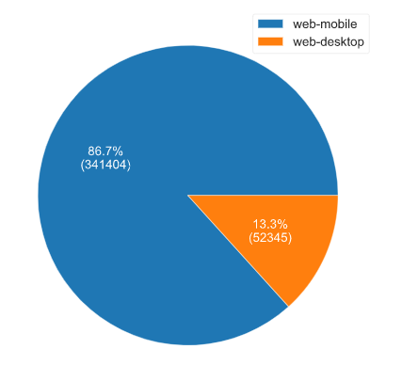
FAVORABLE PLATFORM 1ST = web-mobile (86.7%) 2ND = web-desktop (13.3%)
Value | Count | Frequency (%)
web-mobile | 341404 | 86.7%
web-desktop | 52345 | 13.3%

